Slide 1
Cinemunchies
Team Urkel
May 2018
Notes:
Kimberly
<number>

Slide 2
Team Urkel
What’s Been Missing
Description of project
Project structure
Project selection process
Our approach
Tools and technologies
Features and functions
Our challenges
Our successes
What we learned
Next Steps
Questions & answers
Contents
Notes:
<number>

Slide 3

Team Urkel
Kalsang Bhutia
Robyn Craig
Zac Keilholz
Kimberly Maturo-Hilt
Notes:
<number>

Slide 4

Mission & Value
Mission:
Design a collaborative space that links love of the cinema and the love of munchies together for an ahhhh, ohhhhh or WOW experience.
Value:
We aim to deliver creativity and ease to our solutions as well as our love and passion for food and movies to our customer experience.
Notes:
<number>

Slide 5

What’s Been Missing
It’s simple, ever watch a movie?
Ever think to yourself, what are they eating?
It looks SO GOOD.
I WANT THAT TOO!
Answered YES to both the above … then CINEMUNCHIES is what you need.
Notes:
Robyn
<number>

Slide 6
Description of Project
We bring the munchies of the movies to you.
Search a movie
See a list of munchies
Select a munchie
Get the recipe
OR
Don’t see the munchie yet, then add to our ever expanding database!
Want to know what movie to pair with a munchie, we got you covered for that too! (future functionality)
Notes:
Robyn
<number>

Slide 7
Project Team Structure
Zac
Solution Architect & Back-end Development
Kalsang
Front-end & Back-end Development
- Overall technical responsible
- Solution design advisory
- Firebase
- Jquery
-Javascript
- AJAX
-API calls
- Overall project management
- Jira administrator
-UX testing and issue identification
- wireframing
Kimberly
Project Manager
UX Tester
Robyn
Front End Development
- Bootstrap
- Matrialize
- HTML
- CSS
- Visual design, imagery, graphics
Notes:
Kalsang
<number>

Slide 8
Project Selection Process
SeeFood
CineMunchies*
Find a Dog Park
Where to meet
SeeFood
Where to Meet
ALL IDEAS
TOP IDEAS
FINAL IDEA
All team members submitted ideas
37 ideas in total
Each team member picked their Top-5
Each idea which received a rating was presented, discussed, challenged and brain-stormed the experience
Narrowed down top choices
Another team was already working on the Where to Meet
All agreed to move forward with SeeFood
New name established upon discussion and input from Jesse for project approval
Name provided by Jesse Mortenson
Notes:
Kalsang
<number>

Slide 9
https://zackeilholz.github.io/CineMunchies/
Product Demonstration
Notes:
Kimberly
<number>

Slide 10
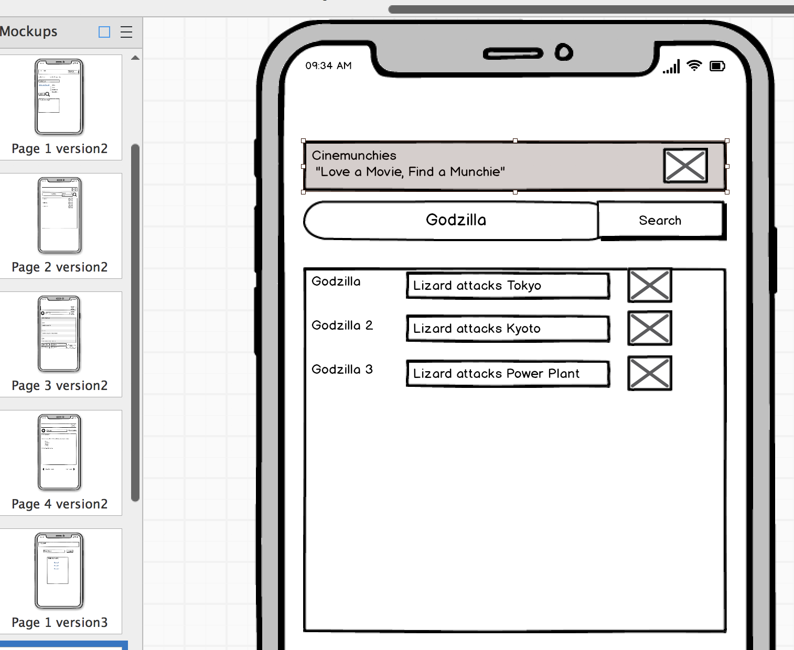
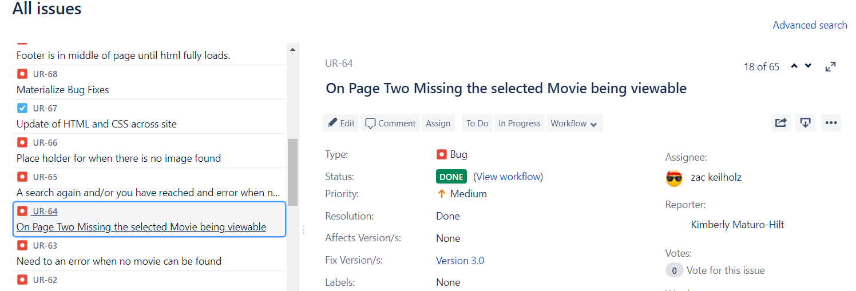
Wireframing
Balsamiq
Hand Sketches
Whiteboarding
Technologies and Approach
Project Management
Jira
Slack Chat
Notes:
Kalsang
<number>

Slide 11
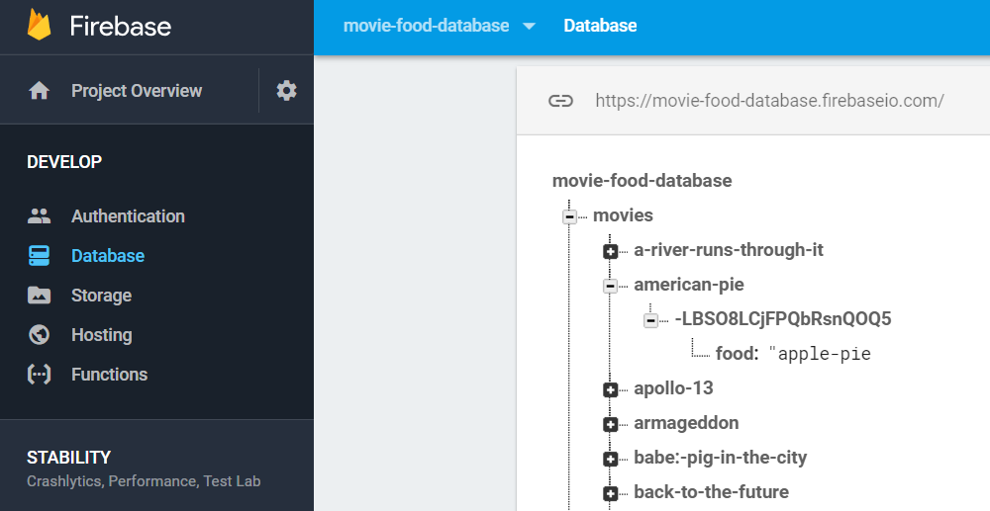

BackEnd
Firebase
Technologies and Approach
Image of our Firebase DB Here
Front End
Materialize
Materialize Logo or Code Here
Notes:
Kalsang
<number>

Slide 12
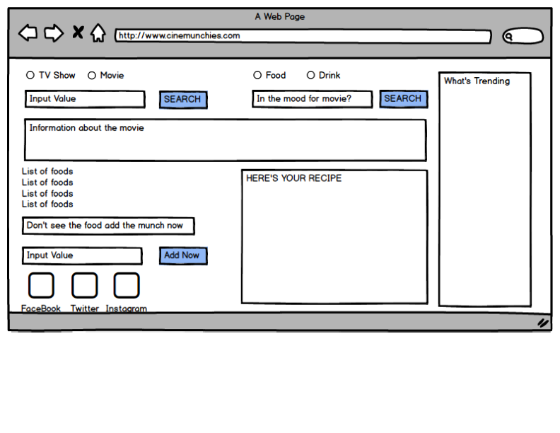
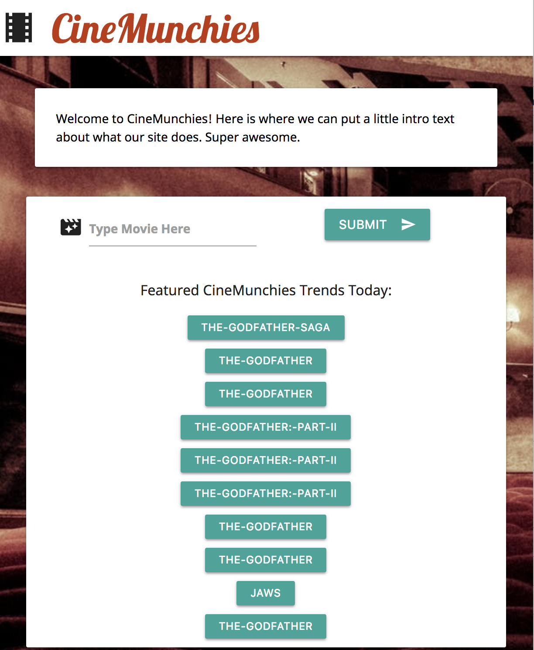
Our Challenges
Branching & Merging
work with TA
trial and error
communication
A single Page format
clearly documenting the experience
testing, testing, testing
Creative Differences
Discuss
COMPROMISE
Notes:
Kalsang
<number>

Slide 13
Our Successes
Positive attitudes
Willingness to listen
Adaptability
Helpfulness
Wanted a mobile solution; kept to the delivering a mobile friend solution
Team work
Mobility
2 API calls
Firebase Database used in 2 ways
Clean
Crisp
Simple
Functionality
Design
Notes:
Zac
<number>

Slide 14


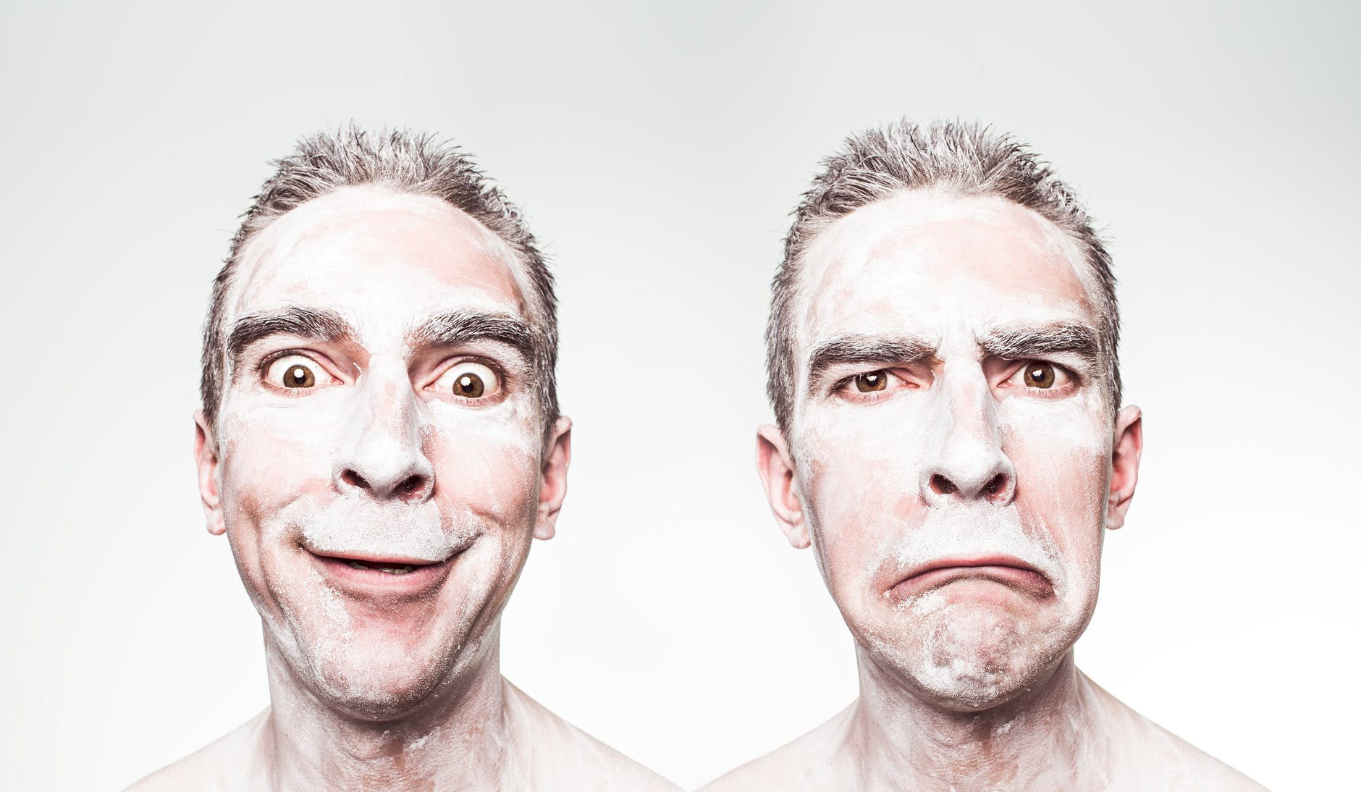

What We Learned
Communicate, there is never enough talking
Prioritize the deliverable
Accept CHANGE in Course
Test and then test again
Notes:
Consider talking about:
Constraints vs Objectives
<number>

Slide 15
Next Steps
Getting Accurate Data:
User Profiles
Up/Downvoting
Additional Meta Data (Time Food was Eaten in Movie, Who ate it, etc etc)
Work on RegEx for Filtering User Input/Searches
Added Features:
Reverse search (Search by Foods)
Back Button
Search Local Restaurants for Food/Order Via Bite Squad
User Favorites – Bookmarks for Foods/Movies/Recipes
Share on Social Media
Monetization
Notes:
Zac
<number>

Slide 16

Questions & Answers
Notes:
<number>

